Slide 1


Slide 2


Slide 3
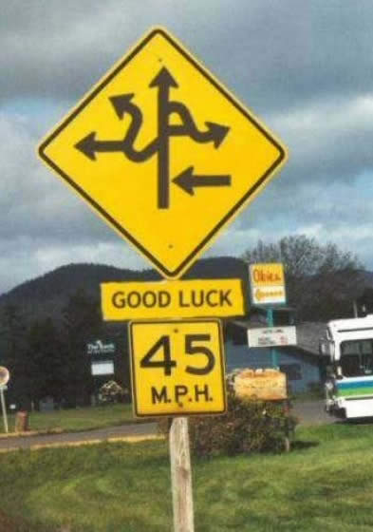
This is a puzzling traffic sign. Where did she go?

Slide 4
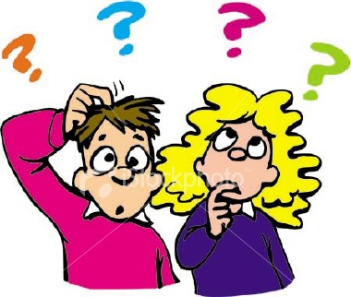
This is a puzzling mystery.

Slide 5

We have some clues

Slide 6
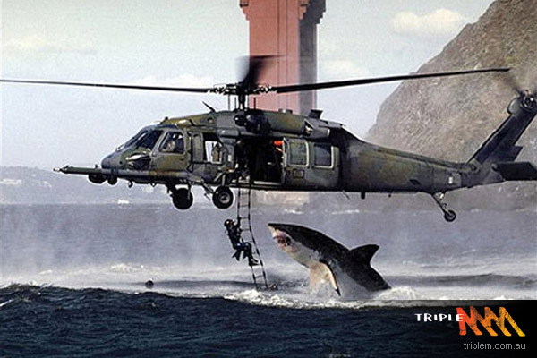

Slide 7
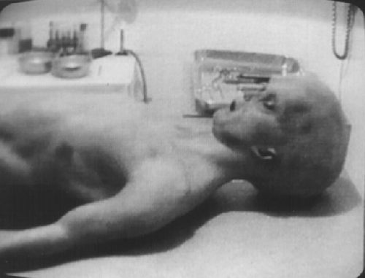

Slide 8
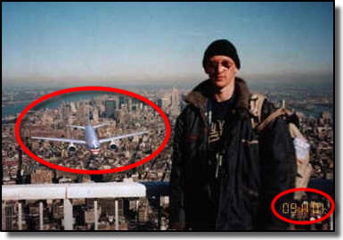

Slide 9
